Slide 1
TODO
Lada’s tests -> approval test (of the list) -> better printing
Full printed story -> whitespace -> json
Pretty printed json -> inline -> everywhere
everywhere -> single instance -> some can’t convert
dual conversations (.and) -> some can’t convert v2 -> setting state

Slide 2
Better Testing with Approvals
Llewellyn Falco
Lada Kesseler

Slide 3
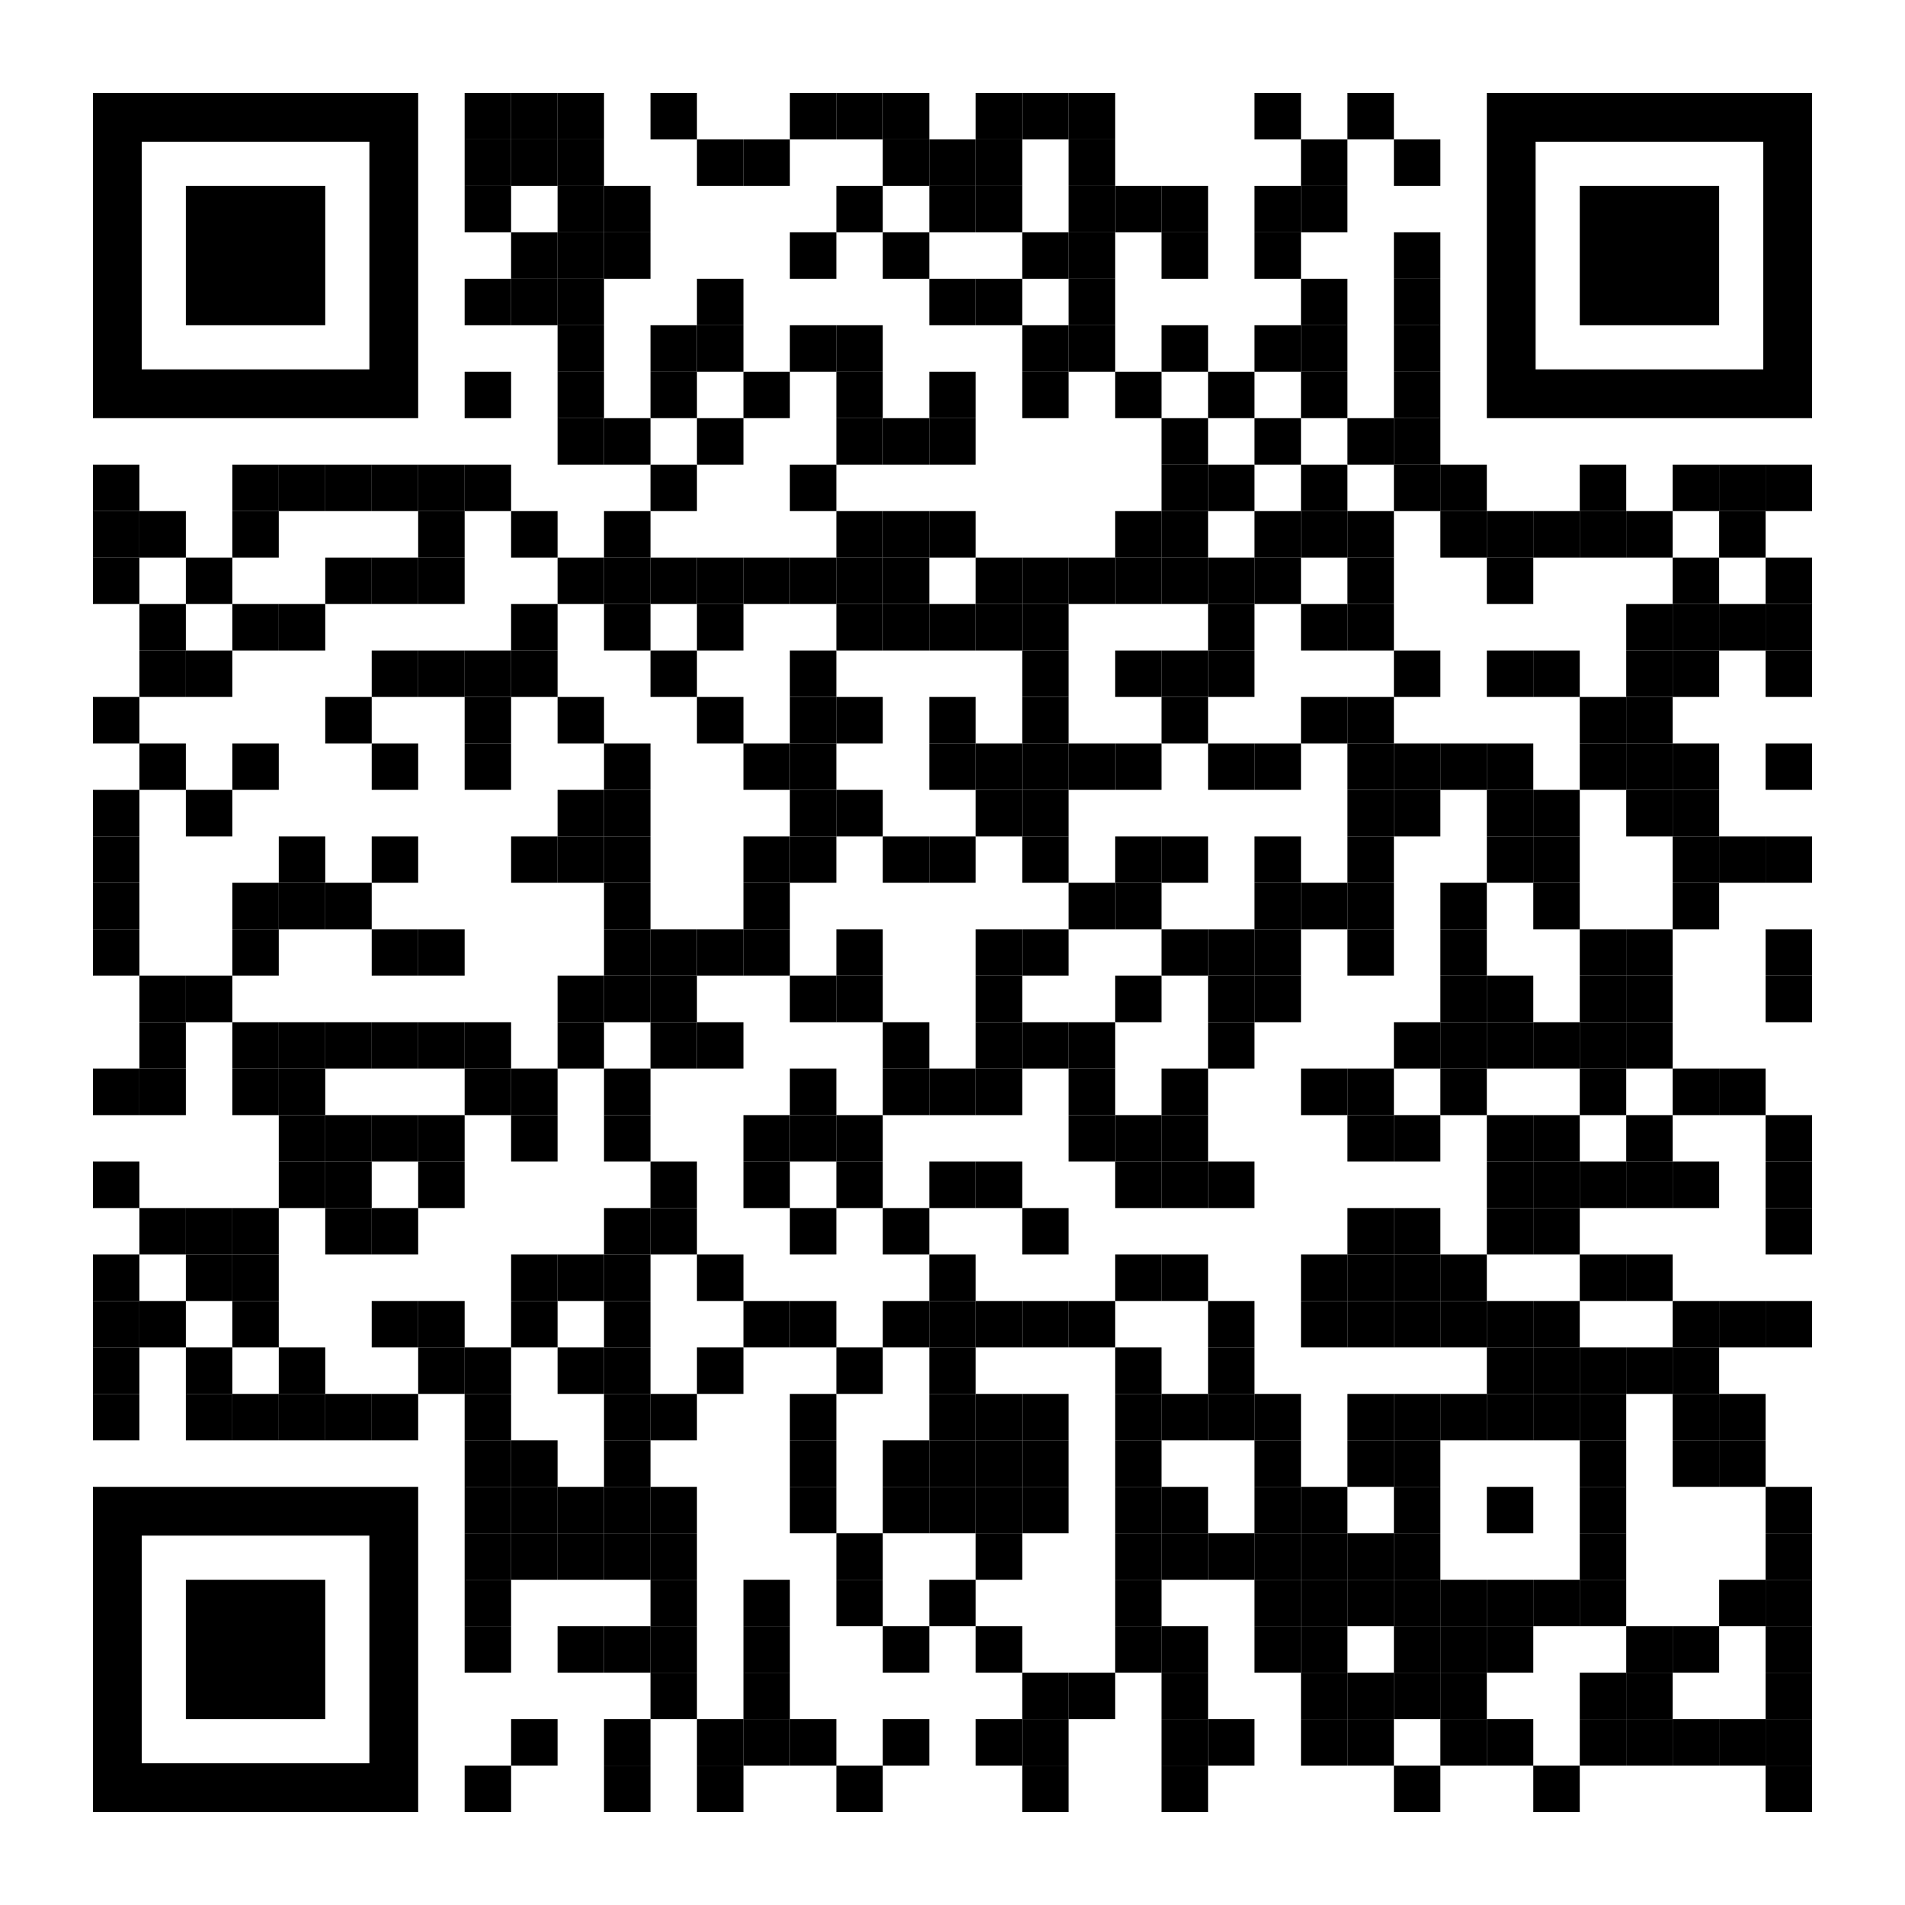
Resources
Notes:
https://github.com/isidore/Talks/blob/master/BetterTestingWithApprovals.md

Slide 4
Clear
Expressive
Simple

Slide 5

In the beginning...

Slide 6
code

Slide 7
Problem:
What the test does is confusing

Slide 8
New Concept:
Testing Circle

Slide 9
// Create side (0,0) – (3,4)
// Verify length
Whiteboard
English
Testing Circle
Result
Code
Side (0,0) – (3,4) length = 5
Side s = new Side(0,0,3,4);
Approvals.Verify(s + “ length = “ +s.Length);

Slide 10
Chat
[Customer]
hi
[Bot]
Hi there! I'm your virtual assistant.
What would you like to do today?
Notes:
we put the focus on what it is that we're testing, and not the setup of the test

Slide 11
Chat
[Customer]
hi
[Bot]
Hi there! I'm your virtual assistant.
What would you like to do today?
Whiteboard
English
Testing Circle
Result
Code

Slide 12
Chat
[Customer]
hi
[Bot]
Hi there! I'm your virtual assistant.
What would you like to do today?
// customer says ‘hi’
// verify conversation
Whiteboard
English
Testing Circle
Result
Code

Slide 13
Chat
[Customer]
hi
[Bot]
Hi there! I'm your virtual assistant.
What would you like to do today?
// customer says ‘hi’
// verify conversation
Whiteboard
English
Testing Circle
Result
Code
String userMessage = "hi"; verifyConversation(userMessage);

Slide 14
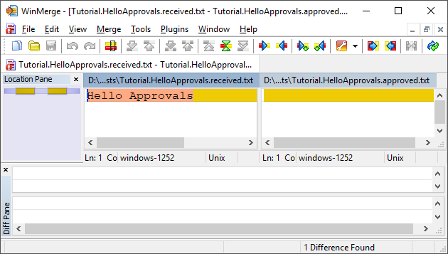
New Concept:
Approval Tests
Test + approved output

Slide 15

Chat
[Customer]
hi
[Bot]
Hi there! I'm your virtual assistant.
What would you like to do today?
// customer says ‘hi’
// verify conversation
Whiteboard
English
Testing Circle
Result
Code
String userMessage = "hi"; verifyConversation(userMessage);

Slide 16
Chat
[Customer]
hi
[Bot]
Hi there! I'm your virtual assistant.
What would you like to do today?
// customer says ‘hi’
// verify conversation
Whiteboard
English
Testing Circle
Result
Code
[Customer]: hi
String userMessage = "hi"; verifyConversation(userMessage);

Slide 17
Week 1
What happened
Notes:
Pay attention to the testing circle
Create convenience functions to hide unnecessary details

Slide 18
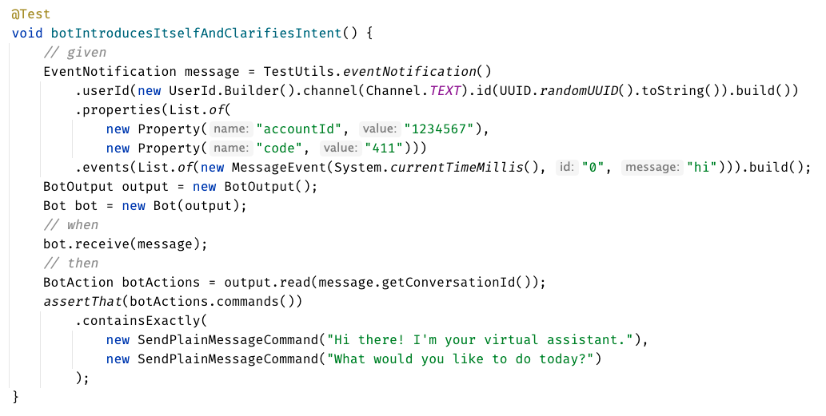

Slide 19
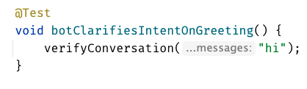


Slide 21
Week 1
learnings
Notes:
Pay attention to the testing circle
Create convenience functions to hide unnecessary details

Slide 22
...later next week...

Slide 23
code

Slide 24
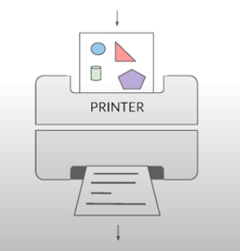
New Concept:
Printers
@EmillyBache

Slide 25

New Concept:
Story Board

Slide 26
Problem:
Lack of clarity in the test code output

Slide 27
Chat
[Customer]
hi
[Bot]
Hi there! I'm your virtual assistant.
What would you like to do today?
[Customer]
pay bill
[Bot]
Are you a customer?
Yes, I'm a customer No, I'm not

Slide 28
[Customer]: hi [ Bot]: Hi there! I'm your virtual assistant. [ Bot]: What would you like to do today? [Customer]: pay bill [ Bot]: Let me try to help you. [ Bot]: { "content": { "type": "vertical", "elements": [ { "type": "text", "text": "Are you a customer?", "tooltip": "text tooltip" }, { "type": "horizontal", "elements": [ { "type": "button", "title": "Yes", "click": { "actions": [ { "type": "publishText", "text": "Yes, I'm a customer" } ] } }, { "type": "button", "title": "No", "click": { "actions": [ { "type": "publishText", "text": "No, I'm not" } ] } } ] } ] } }
Chat
[Customer]
hi
[Bot]
Hi there! I'm your virtual assistant.
What would you like to do today?
[Customer]
pay bill
[Bot]
Are you a customer?
Yes, I'm a customer No, I'm not

Slide 29
Week 1
What happened
Notes:
Pay attention to the testing circle
Create convenience functions to hide unnecessary details

Slide 30
Formatting
[Customer]: hi [Bot]: Hi there! I'm your virtual assistant. [Bot]: What would you like to do today?
[Customer]: hi [ Bot]: Hi there! I'm your virtual assistant. [ Bot]: What would you like to do today?

Slide 31
Formatting
[Customer]: hi [Bot]: Hi there! I'm your virtual assistant. [Bot]: What would you like to do today? [Customer]: hi [Bot]: Hmmm, tell me a little more so I can help you. What would you like to do today? [Customer]: hi [Bot]: Let me try to help you. [Bot]: Are you a customer? 1) Yes, I'm a customer 2) No, I'm not
[Customer]: hi
[ Bot]: Hi there! I'm your virtual assistant. [ Bot]: What would you like to do today? [Customer]: hi [ Bot]: Hmmm, tell me a little more so I can help you. [ ]: What would you like to do today? [Customer]: hi [ Bot]: Let me try to help you. [ Bot]: Are you a customer? [ ]: 1) Yes, I'm a customer [ ]: 2) No, I'm not

Slide 32
[Customer]: hi [ Bot]: Hi there! I'm your virtual assistant. [ Bot]: What would you like to do today? [Customer]: pay bill [ Bot]: Let me try to help you. [ Bot]: { "content": { "type": "vertical", "elements": [ { "type": "text", "text": "Are you a customer?", "tooltip": "text tooltip" }, { "type": "horizontal", "elements": [ { "type": "button", "title": "Yes", "click": { "actions": [ { "type": "publishText", "text": "Yes, I'm a customer" } ] } }, { "type": "button", "title": "No", "click": { "actions": [ { "type": "publishText", "text": "No, I'm not" } ] } } ] } ] } }
[Customer]: hi [ Bot]: Hi there! I'm your virtual assistant. [ Bot]: What would you like to do today? [Customer]: pay bill [ Bot]: Let me try to help you. [ Bot]: Are you a customer? [ ]: 1) Yes, I'm a customer [ ]: 2) No, I'm not

Slide 33
Week 2
learnings
Notes:
Pay attention to the testing circle
Create convenience functions to hide unnecessary details

Slide 34
...later next week...

Slide 35
code

Slide 36
Problem:
Too many .approved. files

Slide 37
New Concept:
Inline Approvals

Slide 38
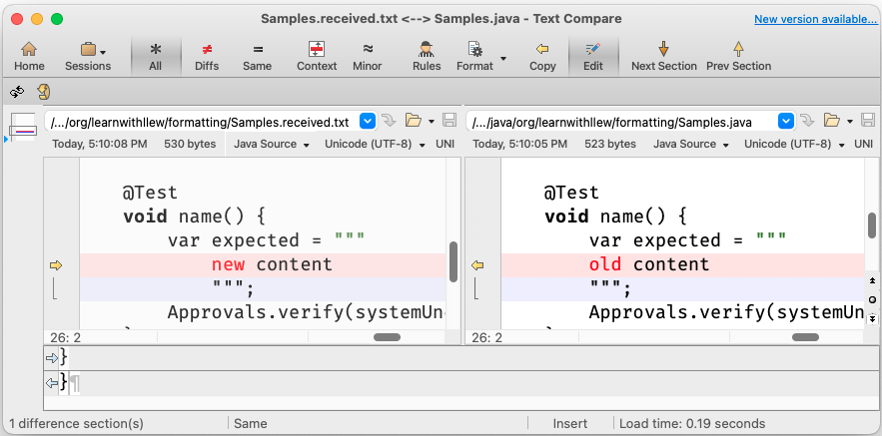
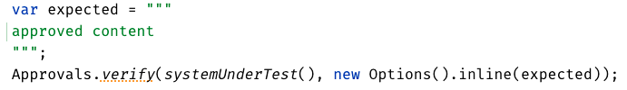
New Concept:
Inline Approvals
“Look mom, no files!”
Possible new source file
Original source file
Approved output
How to invoke
Pressing this modifies
your source code

Slide 39
Week 1
What happened
Notes:
Pay attention to the testing circle
Create convenience functions to hide unnecessary details

Slide 40
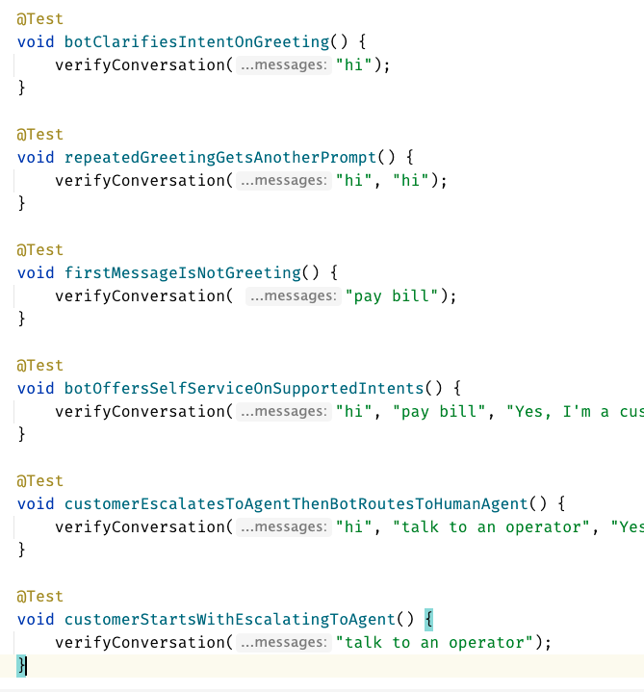
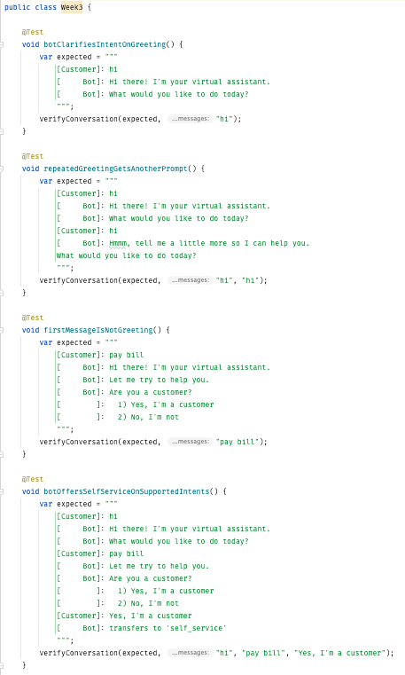
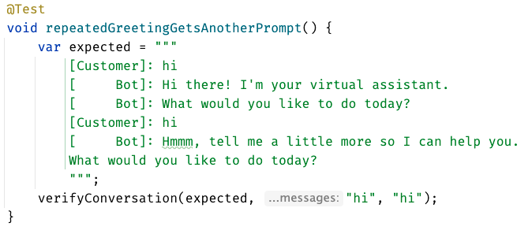
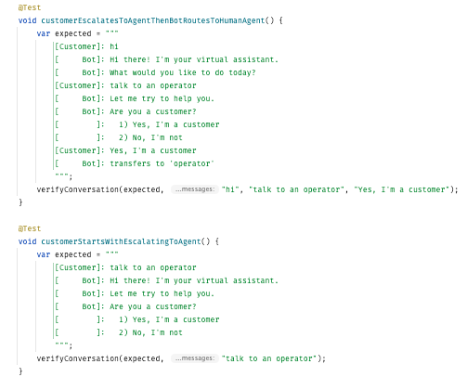
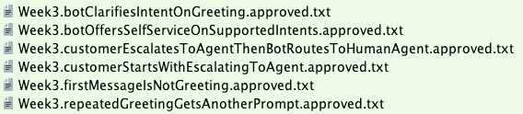

Slide 41
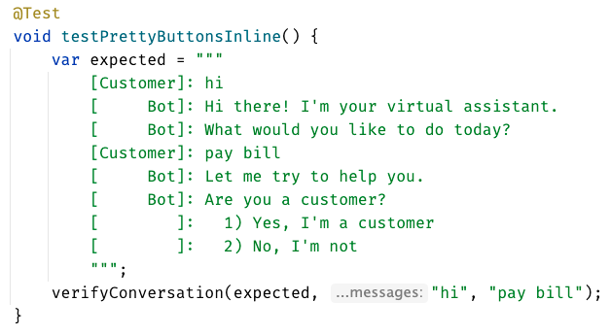
inline - everything in test

Slide 42
Week 3
learnings
Notes:
Pay attention to the testing circle
Create convenience functions to hide unnecessary details

Slide 43
...later next week...

Slide 44
code
Notes:
Hey Llewellyn, look what I did

Slide 45
Problem:
Can’t see the overall test strategy
hard to see if you’re missing cases...

Slide 46
New Concept:
verifyAll()

Slide 47
New Concept:
many of one

Slide 48
Week 4
What happened
Notes:
Pay attention to the testing circle
Create convenience functions to hide unnecessary details

Slide 49
Remember this:
When you have a lot of similar scenarios, allow yourself to see both the forest and the trees
Notes:
Stay on the same level of abstraction as the testing circle

Slide 50
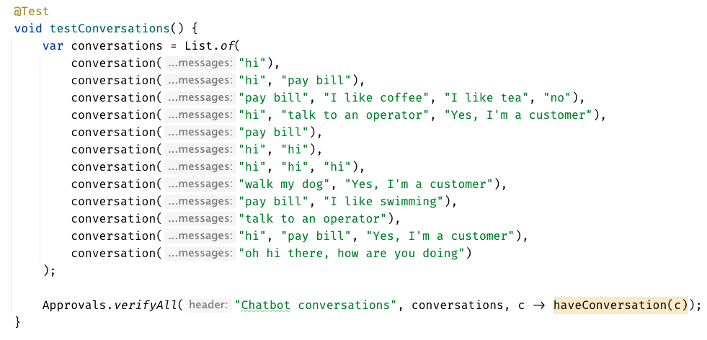

Slide 51
Week 4
learnings
Notes:
Pay attention to the testing circle
Create convenience functions to hide unnecessary details

Slide 52
...later next week...

Slide 53
code
Notes:
Hey Llewellyn, look what I did

Slide 54
Problem:
95% of tests are together
but 5% are alone...

Slide 55
New Concept:
Custom test scenario builders
creating Domain-Specific Language (DSLs)

Slide 56
Week 5
What happened
Notes:
Pay attention to the testing circle
Create convenience functions to hide unnecessary details

Slide 57
var conversation1 = conversation("pay bill", "Yes, I'm a customer"); var conversation2 = conversation("pay bill"); var conversations = List.of(conversation1, conversation2);
conversation("pay bill", "No, I'm not") .thenConversation("pay bill")

Slide 58
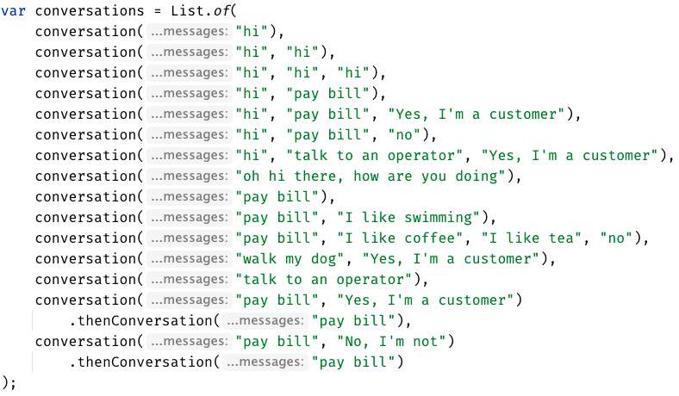

Slide 59
Week 5
learnings
Notes:
Invest in APIs that make it easier to express test scenarios

Slide 60
...later next week...

Slide 61
code
Notes:
Hey Llewellyn, look what I did

Slide 62
Problem:
The tests are only for developers

Slide 63
New Concept:
Alternative .approved. files
new Options().forFile().withExtension(".md")
Notes:
stakeholders

Slide 65
can see only
up to here
foggy
as the details disappear,
we get to see the next layer
person

Slide 66
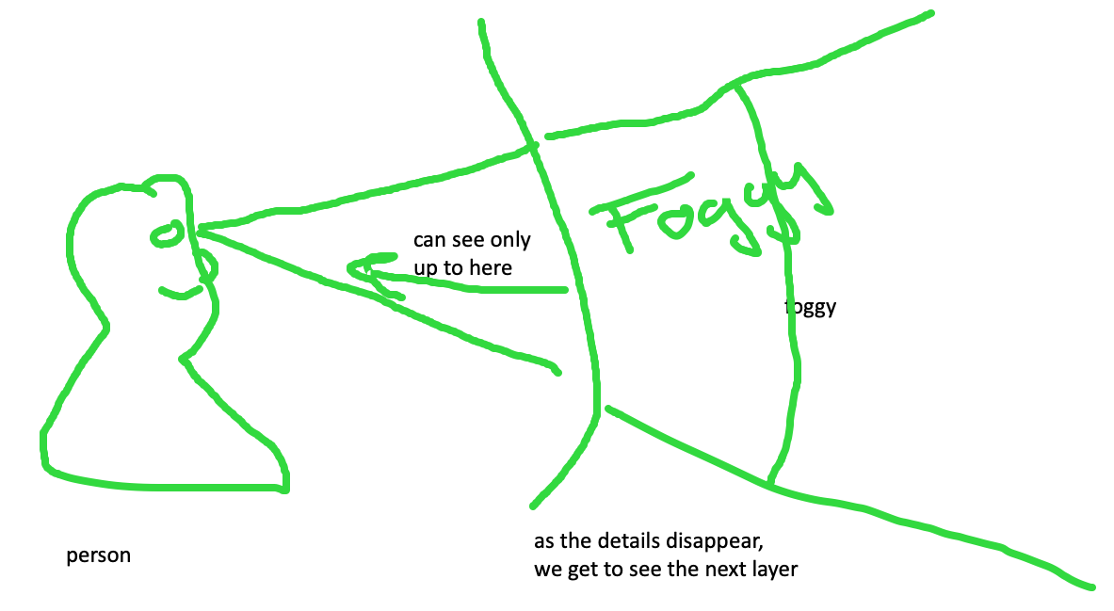
feedback loop – too hard and impossible is the same thing, stop to look

Slide 68
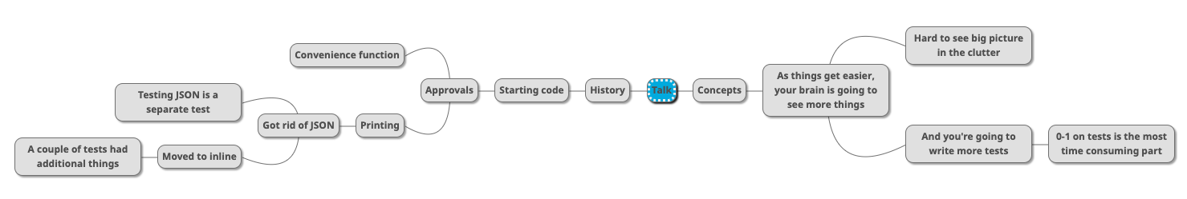

Slide 69
Rest Calls

Slide 70
Consider paths we took:
wordy Java tests
made a printer
made a good printer – not a json: Json test // TODO the json tests
made the inlining – makes it easier to read the whole test better
did multiple conversations
now we can see individual tests, but we can’t see the big picture – so we moved it to the uber test – can delete the other files

Slide 71
Original
@Test public void shouldGetCustomerFromService() { // given accountType = CustomerAccountTypeInfo.builder().account(ACCOUNT_ID).accountType(”PERSONAL").subscription(”MONTHLY").build(); when(responseEntity.getBody()).thenReturn(accountType); // when CustomerAccount result = customerService.retrieveAccount(ACCOUNT_ID); // then CustomerAccount expectedCustomerAccount = new CustomerAccount(ACCOUNT_ID, CustomerPaymentType.MONTHLY, "PERSONAL"); assertThat(result, is(expectedCustomerAccount)); verify(restTemplate, times(1)).exchange(calledUrlCaptor.capture(), eq(HttpMethod.GET), sentHttpEntityCaptor.capture(), any(Class.class)); verifyHeadersAreValid(sentHttpEntityCaptor.getValue().getHeaders()); }

Slide 72
Approval Text
Recorded call to : Conversation Details API
REQUEST
--------------------------------------------------------------------------------
Method : GET
Called Url: /api/v1.2/message/id/500
Headers :
{
"Authorization" : [ "Basic fake" ],
"Cache-Control" : [ "no-cache" ]
}
Body :
null
EXAMPLE RESPONSE
--------------------------------------------------------------------------------
{
"data": [
{
"displayNumber": "500",
"encodedCaseDisposition": 27,
"uuid": "uuid-1",
"createDate": 0,
"responsePortalLink": "/portal/message/500",
"primaryMessage": {
"conversationDisplayId": "500",
"network": "twitter",
"networkInstance": "twitter",
"receiveDate": 0,
"publishDate": 0,
"tags": [
],
"private": true
},
"messages": [
{
"conversationDisplayId": "500",
"network": "twitter",
"networkInstance": "twitter",
"receiveDate": 0,
"publishDate": 0,
"tags": [
],
"private": true
}
],
"tags": [
{
"creator": {
"type": "BOT"
},
"tagId": "34",
"uuid": "uuid2"
}
],
"priority": 4,
"lswPermalink": "/console/bot/500",
"totalResponses": 2,
"hasResponse": false,
"status": "IN_PROGRESS"
}
]
}

Slide 73
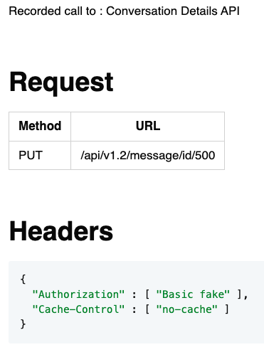
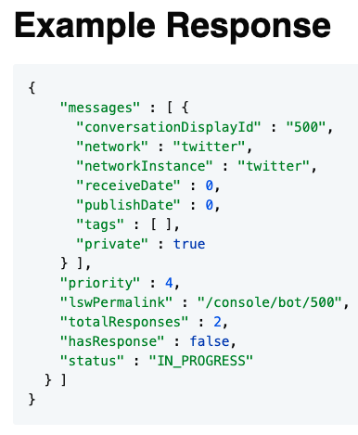
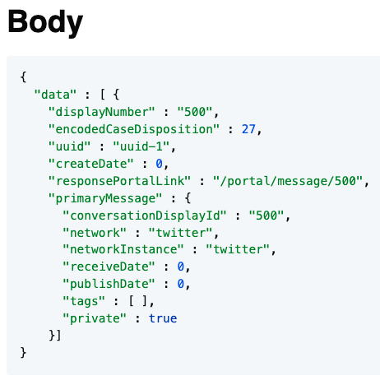
Approval Markdown
2-5 min - Lightning talk?

